Slide 1


RUI.XU
2023.5.10

Slide 2

Outline
Executive Summary
Introduction
Methodology
Results
Conclusion
Appendix

Slide 3
Executive Summary
Summary of methodologies
Summary of all results

Slide 4
Introduction
Project background and context
Problems you want to find answers

Slide 5

Section 1

Slide 6
Methodology
Executive Summary
Data collection methodology:
To know where are the data stored
Use the python`s tool to scratch information
Perform data wrangling
To deal with the confusion data(like missing values)
Perform exploratory data analysis (EDA) using visualization and SQL
Perform interactive visual analytics using Folium and Plotly Dash
Perform predictive analysis using classification models
How to build, tune, evaluate classification models

Slide 7
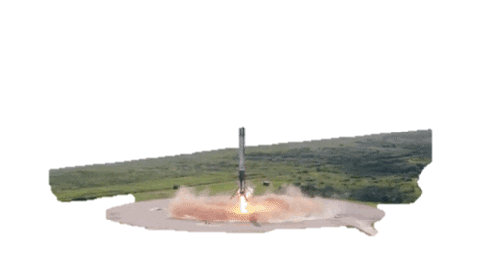
Data Collection – SpaceX API
SpaceX advertises Falcon 9 rocket launches on its website with a cost of 62 million dollars;
other providers cost upward of 165 million dollars each
Reason
Reuse the first stage
Study
The key factors
Object
Frist stage
successfully
The Falcon 9

Slide 8
Data Collection - Scraping
From website to download the data
https://api.spacexdata.com/v4/launches/past
To choose the key features
'rocket’
'payloads’
'launchpad’
'cores’
'flight_number’
'date_utc'
Filter the data
only include Falcon 9 launches
Use the structure of the website , analysis the content
Discover relevant information
Get 200 records from the website
Normalize the data form as json
Get the main columns
Transform form like dataframe
Place your flowchart of web scraping here
https://github.com/yvonne1989-cloud/finaltest/blob/main/jupyter-labs-spacex-data-collection-api.ipynb

Slide 9
Data Wrangling
Deal with the null data
As use the code—(isnull)—to find how much null were there
We find 5 of PlayloadMass and 26 of LandingPad
Deal with the missing data
Use mean of those data to fill
As result we can get a table with no missing values
https://github.com/yvonne1989-cloud/finaltest/blob/main/labs-jupyter-spacex-Data%20wrangling.ipynb

Slide 10
EDA with Data Visualization
We use about three plots to show the relationship between those factors:
1.Bar:can help us better understand and communicate data, compare the size and trend of different categories or metrics, and identify outliers and trends from them
2.Catplot: used to display the relationship between one continuous variable and one or more categorical variables
3.Line: displays the relationship between two variables as a series of connected points
https://github.com/yvonne1989-cloud/finaltest/blob/main/jupyter-labs-eda-dataviz.ipynb

Slide 11
EDA with SQL
1. SELECT DISTINCT [col] from[table]
2. SELECT * FROM [table] WHERE [conditions]
3. SELECT [formal] FROM [table] WHERE [conditions]
4. SELECT [col1],[col2] FROM [table] GROUP BY [col3]
https://github.com/yvonne1989-cloud/finaltest/blob/main/jupyter-labs-eda-sql-coursera_sqllite.ipynb

Slide 12
Build an Interactive Map with Folium
Markers: Used to mark a point on the map and associate it with a specific location.
Circles: Created with a specific location as the center, typically used to represent an area or a radius.
Lines: Used to connect two or more points on a map, continuous lines can be used to represent routes or paths.
Popups: Used to display a text box when a user clicks on a location on the map. Popup boxes can be used to add explanations or descriptions for locations or issues that appear on the map.
Tiles: Used to set the base style of the map, such as setting a map theme, satellite imagery, or a black and white map.
https://github.com/yvonne1989-cloud/finaltest/blob/main/lab_jupyter_launch_site_location.ipynb

Slide 13
Build a Dashboard with Plotly Dash
We got two graphs in this dash
1.Pie:when we choose the different locations, they will show the percentage of success
2.Scatter:according to the range of payload , they will show the distributions
It`s a explore of looking for the factors how to effect the results
https://github.com/yvonne1989-cloud/finaltest/blob/main/Dashboard%20Application%20with%20Plotly%20Dash.py

Slide 14
Predictive Analysis (Classification)
Data collection
Get features
Get result data
transform
Chip data
Use method
evaluate
choose
We have these steps to get the result:
1.get class of success
2.transform these factors
3.chip the data between test and train
4.use LR\SVC\CSV\Decision Tree\KNN\ method
5.use confusion matrix to evaluate
6.choose the best way to predict
https://github.com/yvonne1989-cloud/finaltest/blob/main/SpaceX_Machine_Learning_Prediction_Part_5.jupyterlite.ipynb

Slide 15
Results
Exploratory data analysis results
Interactive analytics demo in screenshots
Predictive analysis results

Slide 16

Section 2

Slide 17
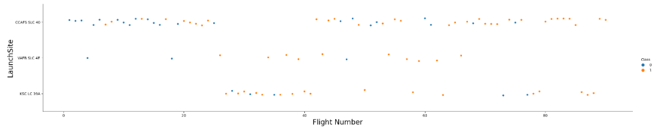
Flight Number vs. Launch Site
Show a scatter plot of Flight Number vs. Launch Site
Show the screenshot of the scatter plot with explanations
To the end of the tests, CCAFS LC-40 have got a higher successful percentage.

Slide 18
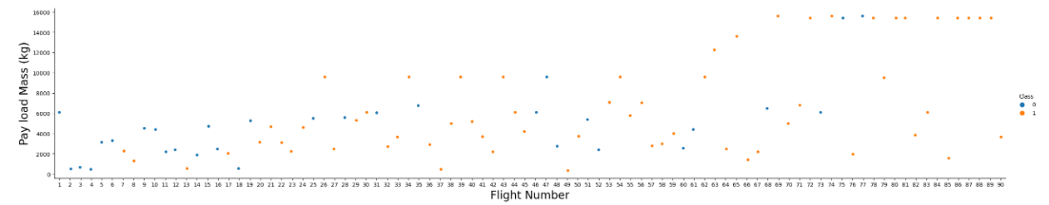
Payload vs. Launch Site
At the beginning of the test, they focus on the lighter load mass . The further we go, the more they choose heavy lift rockets.

Slide 19
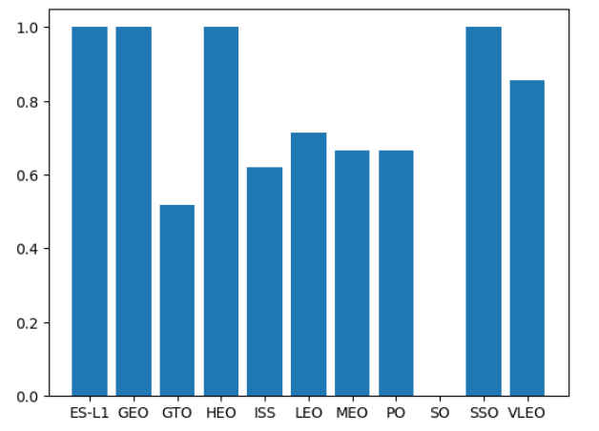
Success Rate vs. Orbit Type
Show a bar chart for the success rate of each orbit type
Show the screenshot of the scatter plot with explanations
Often we think the maintain safe orbit., have a better condition to submit.

Slide 20
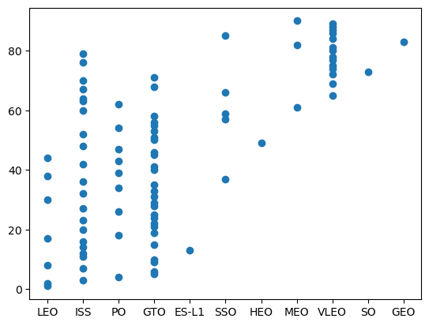
Flight Number vs. Orbit Type
Show a scatter point of Flight number vs. Orbit type
Show the screenshot of the scatter plot with explanations
Taking into account the safety of the orbit, a rocket launch would choose this type of orbit.

Slide 21
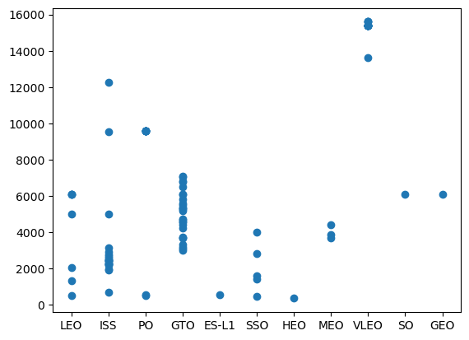
Payload vs. Orbit Type
Show a scatter point of payload vs. orbit type
Show the screenshot of the scatter plot with explanations
With heavy payloads the successful landing or positive landing rate are more for PO,LEO and ISS

Slide 22
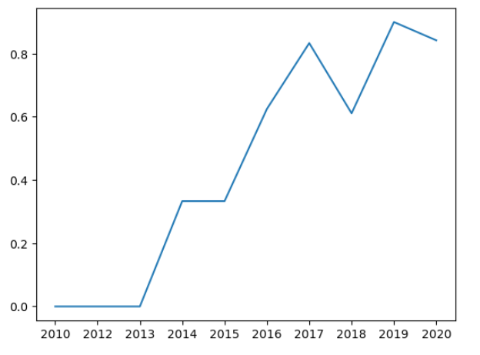
Launch Success Yearly Trend
Show a line chart of yearly average success rate
Show the screenshot of the scatter plot with explanations
Overall, from 2010 to 2020, the success rate of space launches has significantly improved, growing from 0% to around 80%.

Slide 23
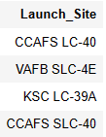
All Launch Site Names

Slide 24
Launch Site Names Begin with 'CCA'
Date | Time (UTC) | Booster_Version | Launch_Site | Payload | PAYLOAD_MASS__KG_ | Orbit | Customer | Mission_Outcome | Landing _Outcome
04-06-2010 | 18:45:00 | F9 v1.0 B0003 | CCAFS LC-40 | Dragon Spacecraft Qualification Unit | 0 | LEO | SpaceX | Success | Failure (parachute)
08-12-2010 | 15:43:00 | F9 v1.0 B0004 | CCAFS LC-40 | Dragon demo flight C1, two CubeSats, barrel of Brouere cheese | 0 | LEO (ISS) | NASA (COTS) NRO | Success | Failure (parachute)
22-05-2012 | 07:44:00 | F9 v1.0 B0005 | CCAFS LC-40 | Dragon demo flight C2 | 525 | LEO (ISS) | NASA (COTS) | Success | No attempt
08-10-2012 | 00:35:00 | F9 v1.0 B0006 | CCAFS LC-40 | SpaceX CRS-1 | 500 | LEO (ISS) | NASA (CRS) | Success | No attempt
01-03-2013 | 15:10:00 | F9 v1.0 B0007 | CCAFS LC-40 | SpaceX CRS-2 | 677 | LEO (ISS) | NASA (CRS) | Success | No attempt
Find 5 records where launch sites begin with `CCA`
Present your query result with a short explanation here

Slide 25
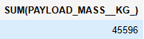
Total Payload Mass
Calculate the total payload carried by boosters from NASA
Present your query result with a short explanation here

Slide 26
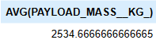
Average Payload Mass by F9 v1.1
Calculate the average payload mass carried by booster version F9 v1.1
Present your query result with a short explanation here

Slide 27
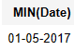
First Successful Ground Landing Date

Slide 28
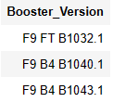
Successful Drone Ship Landing with Payload between 4000 and 6000

Slide 29
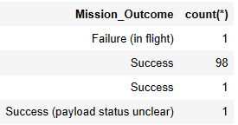
Total Number of Successful and Failure Mission Outcomes

Slide 30
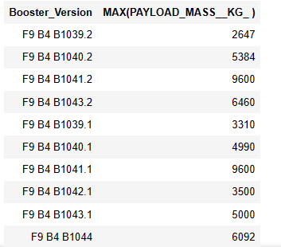
Boosters Carried Maximum Payload

Slide 31
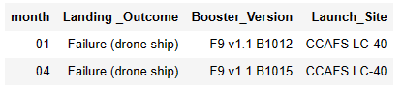
2015 Launch Records
List the failed landing_outcomes in drone ship, their booster versions, and launch site names for in year 2015
Present your query result with a short explanation here

Slide 32
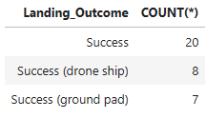
Rank Landing Outcomes Between 2010-06-04 and 2017-03-20

Slide 33

Section 3

Slide 34

<Folium Map Screenshot 1>
Replace <Folium map screenshot 1> title with an appropriate title
Explore the generated folium map and make a proper screenshot to include all launch sites’ location markers on a global map
Explain the important elements and findings on the screenshot

Slide 35
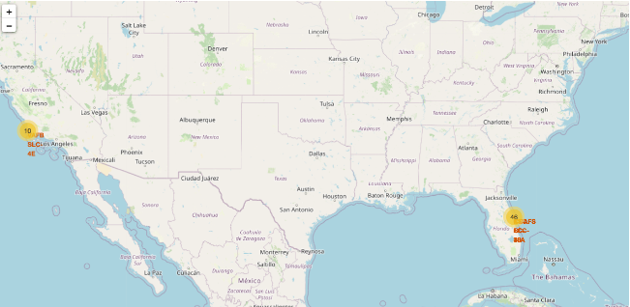
<Folium Map Screenshot 2>
Replace <Folium map screenshot 2> title with an appropriate title
Explore the folium map and make a proper screenshot to show the color-labeled launch outcomes on the map
Explain the important elements and findings on the screenshot

Slide 36
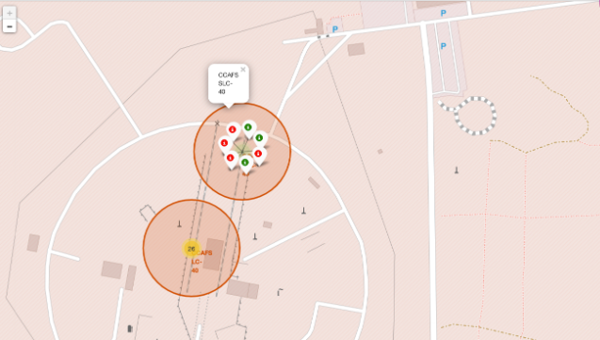
<Folium Map Screenshot 3>
Replace <Folium map screenshot 3> title with an appropriate title
Explore the generated folium map and show the screenshot of a selected launch site to its proximities such as railway, highway, coastline, with distance calculated and displayed
Explain the important elements and findings on the screenshot

Slide 37

Section 4

Slide 38
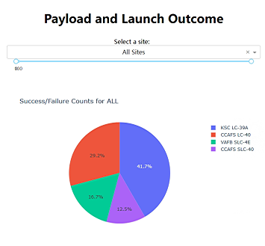
Payload and Launch Outcome
The biggest part is CCAFS LC-40

Slide 39
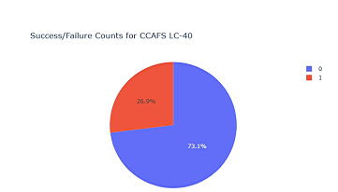
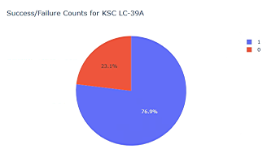
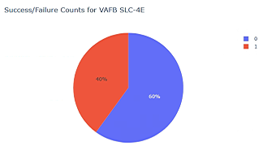
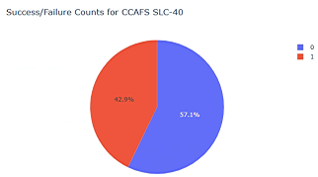
The part of KSC LC-39A Launch Outcome
As we see, the highest successful percentage is KSC LC-39A,is getting 76.9%.

Slide 40
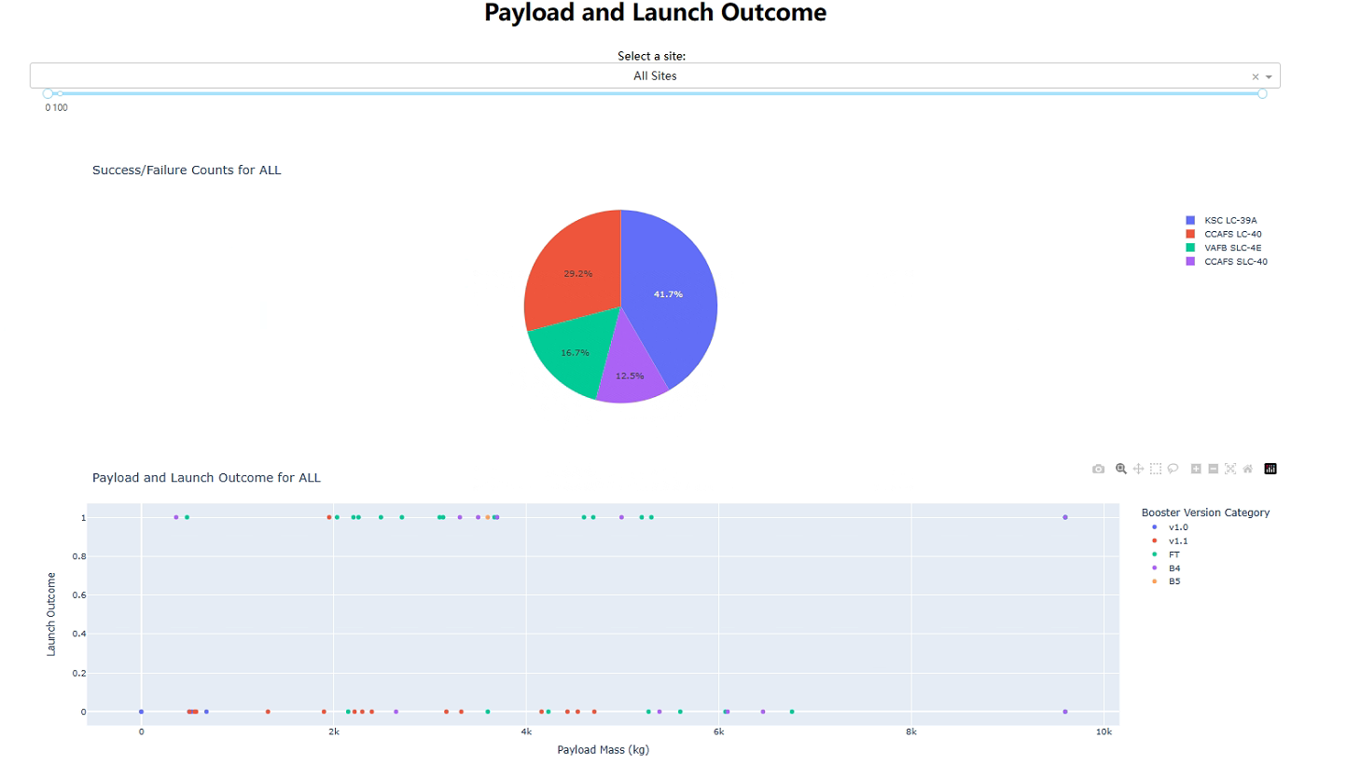
Payload and launch outcome for all
From 2k to 6k may be the best range of payload for submit

Slide 41

Section 5

Slide 42
Classification Accuracy
DecisionTree is the biggest.

Slide 43
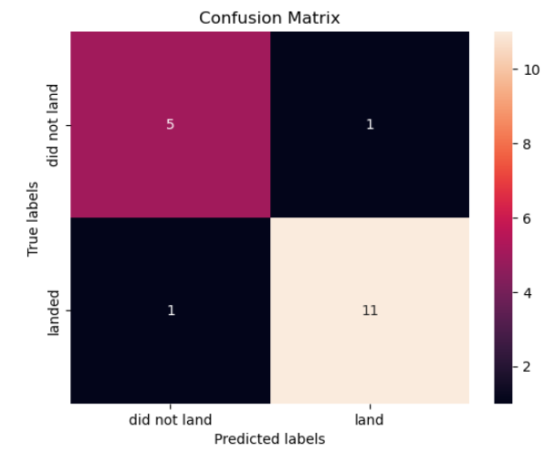
Confusion Matrix

Slide 44
Conclusions
Location: CCAFS LC-40
Loadmass: Avg 2534.66
Orbit: ISS\LEO\PO
Time: After 2017

Slide 45


